Slide 1

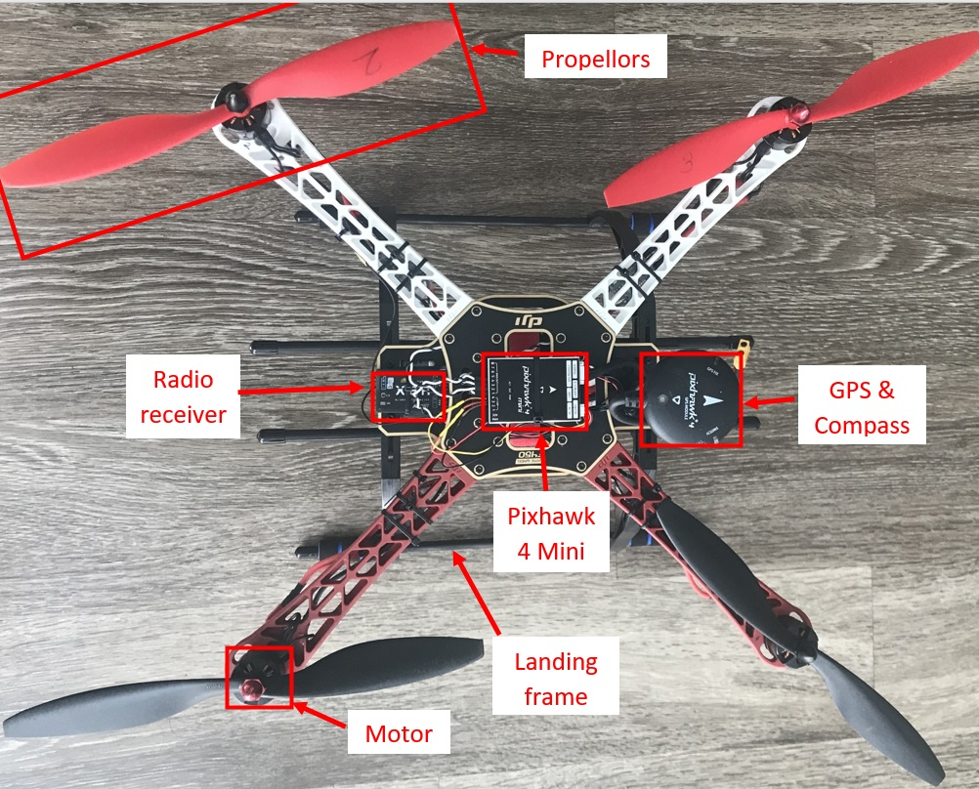
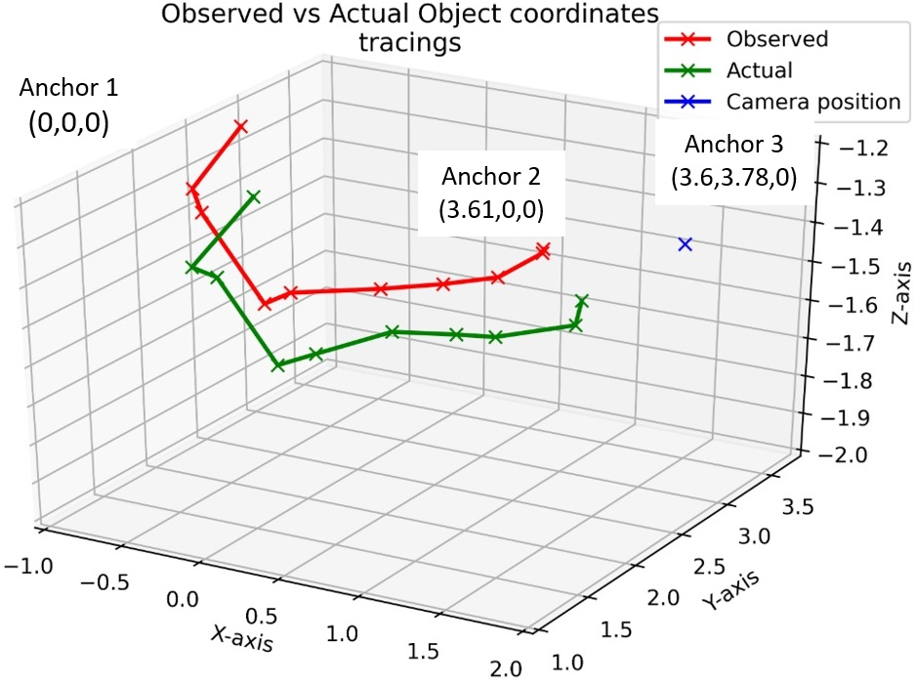
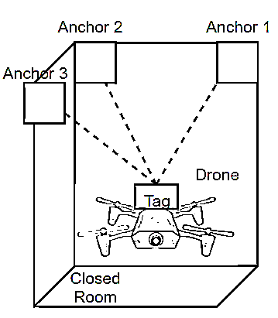
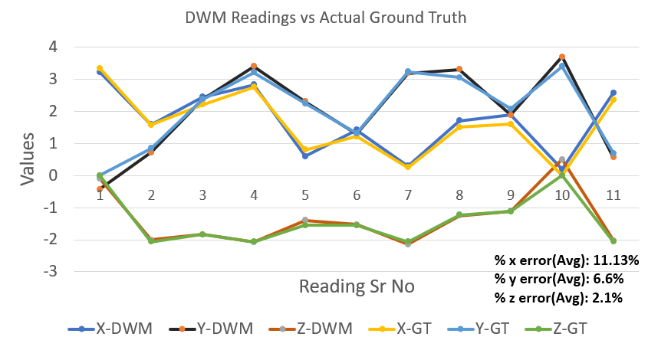
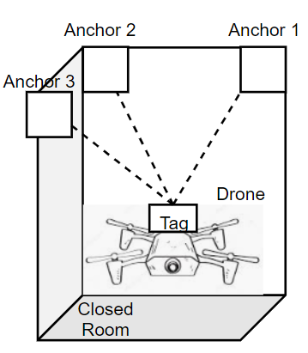
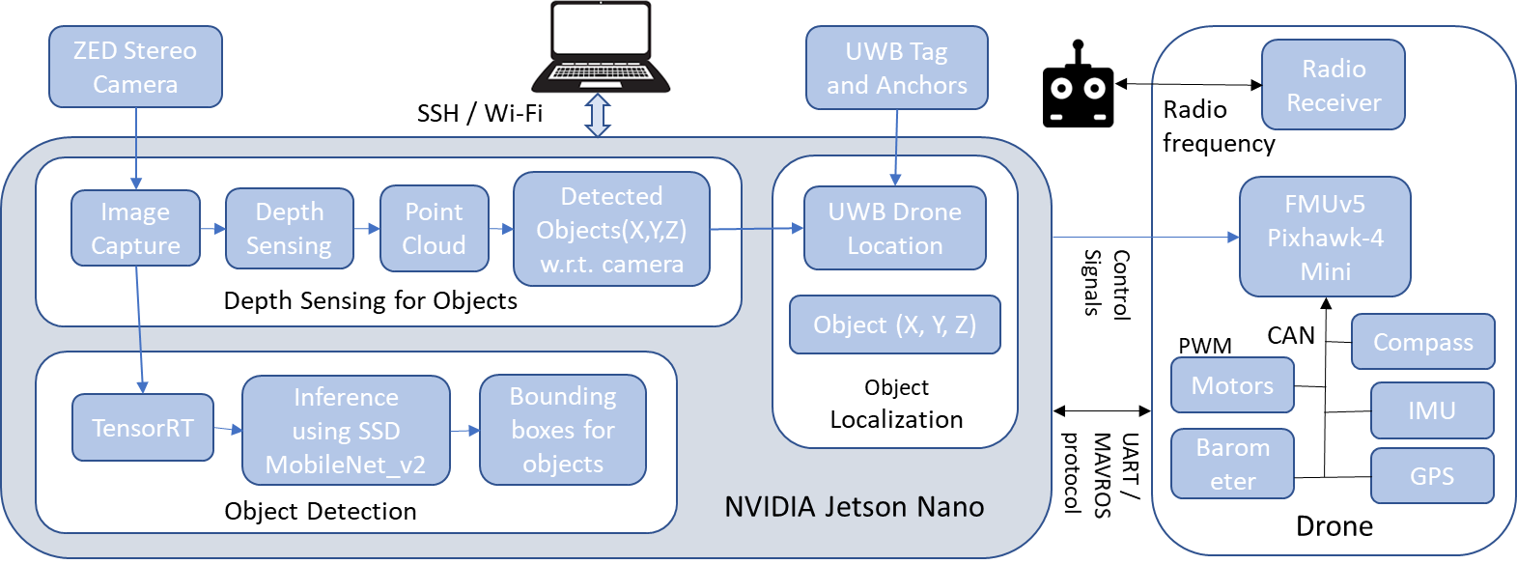
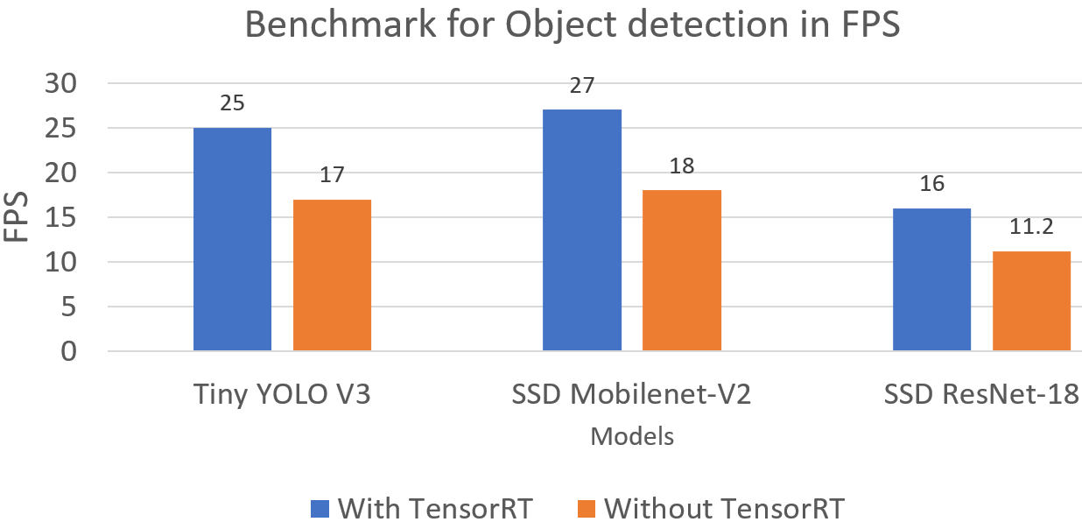
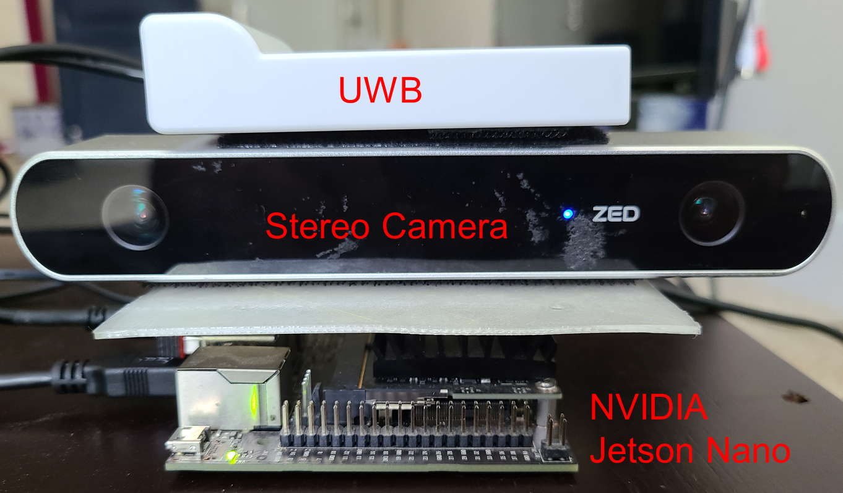
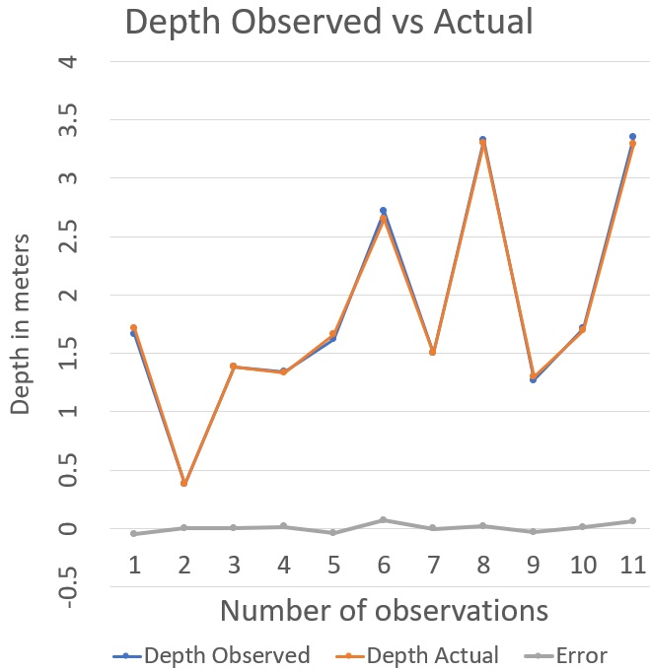
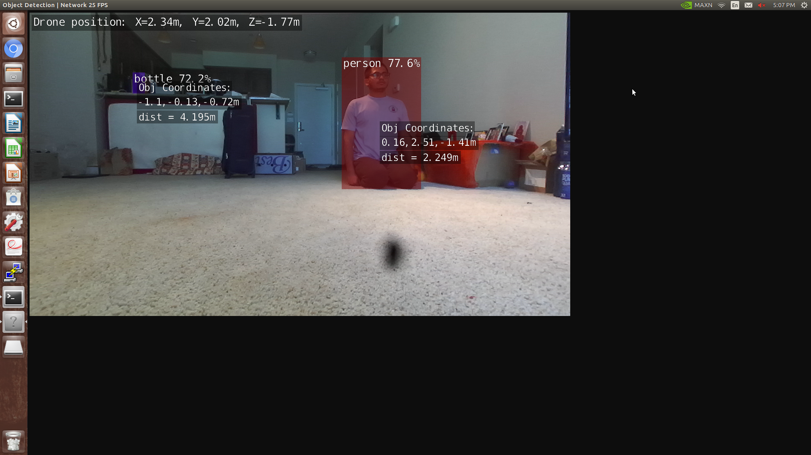
When we configured all the DWM1001 nodes with android app, we were able to see the relative distance between tag and other anchors in Grid View as mentioned below
Computer Engineering Department
Connected and Autonomous Robotic System
Project Advisor: Dr. Kaikai Liu
Gandhi, Prashant (MS Computer Engineering)
Makani, Vatsal (MS Computer Engineering)
Parsana, Jay (MS Computer Engineering)
Shah, Saumil (MS Computer Engineering)
Introduction
Methodology
Analysis and Results
we can see in the Fig 7(a); we saw that the error was ±8cm.
We achieved the object localization and Fig 7(b) shows the detected object with its (X, Y, Z) coordinates. The position of drone attached to UWB tag is also shown. After attaching the UWB module for object localization, we traced an object and compared its ground truth values and observed values w.r.t. the anchor as shown in Fig 8. The error was around ±20cm which is synonymous with the error from the UWB module. Thus, if the error from the UWB is minimized the object localization would be very accurate.
Nowadays autonomous robotic systems are the focus of research in the tech industry. Our project, Connected and Autonomous System, is an amalgam of embedded systems, IoT, distributed sensor networks, and deep learning applications. In this project, we aim to develop a drone that has autonomous capabilities and can track moving objects such as vehicles and people. Its application will be to capture videos or images of these moving objects autonomously. The major components of this project's system are divided into low level and high-level system architecture. Pixhawk 4 mini running PX4 firmware combined with GPS are part of low-level software. The low-level architecture is uses for Ardupilot for autonomous operation. The high-level architecture includes NVIDIA Jetson Nano, ZED Camera, and UWB. High level is used for object detection and localization. Here, the ZED camera is used to measure depth and detect objects. Jetson Nano makes use of RTOS on it and trained machine learning model to detect objects. UWB is used for localization so that we can fly drone indoors without GPS.
Communication Infrastructure: Jetson nano and Pixhawk 4 mini communicates through UART. To send a command from nano to PX4 we need to establish a Pub-Sub link between them which is achieved through MAVLINK. MAVROS converts commands to MAVLINK for controlling the path and operation of drone.
Positioning and localization: The positioning and localization was achieved using DWM1001 with RTLS. We placed 3 DWM1001 at different corners of the room and configured them as anchor as a part of an experimental setup. The DWM1001 along with the camera and drone is configured as a tag.
The coordinates of Anchor1 is (0,0,0), Anchor 2 is (3.61,0,0) and Anchor 3 is (3.8,3.61,0). We evaluated the performance of the DWM1001 by comparing the values of (x,y,z) of the tag with respect to the ground truth.
Depth Sensing and Object Detection:
We make use of NVIDIA Jetson Nano which has a powerful GPU for high performance in small form factor. It aids our deep learning object detection models. For our object detection and depth sensing application, we attached ZED camera which has CUDA based SDK for giving high FPS depth and image data.
UWB Localization:
We evaluated the values of (x,y,z) of tag at different positions inside the closed room and measured the corresponding ground truth and analyzed the data in excel by calculating the percent error parameter. Below is the graph showing the comparative analysis of DWM1001 values versus the actual ground truth values as well as the computed average percentage error for x,y and z axis.
The error of the DWM1001 distances measured relative to the anchors in the android application was nearly around +/-20cm with the accuracy of 92%
Depth Sensing and Object Detection:
For the object detection component of our project we have used TensorRT, a software stack by NVIDIA which accelerates and improves the performance of object detection inference. We compared performance of several object detection such Tiny YOLO V3, SSD MobileNet-V2, and SSD ResNet-18 with and without TensorRT. We concluded that models that use TensorRT have better performance by 30%. We chose SSD MobileNet V2 based on its superior performance which matched our project requirement.
After comparing the ground truth values with the observed values we can say that the accuracy of the depth measurement using ZED camera is around 99.6% up to 5 meters. The graphs above shows low error for depth measurement. After performing experiments, as
Fig 2. Assembled Drone
Fig 8. Object detection and distance of each object from the camera
Fig 5. Object detection and distance of each object from the camera
Methodology
In this paper, we propose a connected and autonomous robotic system using a multi-sensor based autonomous drones. The key feature in our proposed system is to detect obstacles such as birds and other aerial responder units by using a combination of ZED camera and object detection machine learning models in tandem. We have implemented a UWB based RTLS network and depth sensing to achieve localization in indoor conditions.
Summary/Conclusions
In this paper, we have presented a connected and autonomous robotic system that integrates multiple sensors for obstacle detection, depth perception, and UWB localization and integration of these features into our drone. Our project provides a powerful platform to analyze the difficult situation in times of flight in an indoor environment. The project also demonstrates a software framework that simulates current norms and standards for autonomous flight. We could extend our project to a drone that can track moving objects such as vehicles and people, surveillance of indoor environment and autonomous food delivery.
Fig 3 DWM1001 setup inside a closed room
Key References
[1] Kara, D. (2004). Sizing and seizing the robotics opportunity, RoboNexus. This text can be accessed online at Robotics Trends Inc. http://www.roboticsevents.com/ robonexus2004/roboticsmarket.html Accessed 12.06.19
[2] Koh, Lian Pin, and Serge A. Wich. "Dawn of drone ecology: low-cost autonomous aerial vehicles for conservation." Tropical Conservation Science 5.2 (2012): 121-132.
[3] Erdelj, Milan, Michał Król, and Enrico Natalizio. "Wireless sensor networks and multi-UAV systems for natural disaster management." Computer Networks 124 (2017): 72-86.
[4] “About,” ArduPilot. [Online]. Available: https://ardupilot.org/about. [Accessed: 07-Dec-2019].
[5] “Advantages of using Ultra Wideband (UWB) technology for Indoor Positioning”[Online]. Available: https://hackernoon.com/https-medium-com-pathpartnertech-ultra-wideband-uwb-technology-for-indoor-positioning-a5fbe76d6a4c [Accessed: 13-Apr-2020]
[7] Mai, Vincent, et al. "Local Positioning System Using UWB Range Measurements for an Unmanned Blimp." IEEE Robotics and Automation Letters 3.4 (2018): 2971-2978
Fig 6. Performance comparison for models using TensorRT
Fig 1. System Architecture
Drone module:
We have used a DJI F450 Quadcopter X frame for this project. We are using Emax MT2213-935KV brushless motor which supports 20A – 30A ESCs, LittleBee BLHeils 30A ESC which supports 2-6s batteries. For the autopilot system, we are using Pixhawk 4 mini open source autopilot hardware which uses NuttX OS and PX4 Ardupilot firmware. For the live location of drone, we are using ublox GPS. To control the drone remotely, we are using the FrSky Taranis Q X7 radio transmitter and x8r receiver. We have 3D printed support for Jetson nano. Batteries shall power all ESCs, GPS, Pixhawk 4 mini, and Jetson Nano using a power management module.
Depth Observed vs Actual
(a)
(b)
Acknowledgements
Fig 7 (a).Depth Observed vs Actual. (b) Result with object localization w.r.t anchor
We would sincerely like to thank our project advisor Dr. Kaikai Liu for his guidance and support throughout the project.
Fig 4. DWM1001 tag with Jetson Nano and ZED camera

